Slide 1
(2) Integration: When & How
Warning: We use a less restricted notion of integration than many others ...
Fundamental Techniques for Integration:
[Giese+2011]
Notes:
It has to be noted that in contrast to more restricted interpretations of the term integration (cf. [9]) we do not limit integration to the case where checks at composition time are employed, but also include the case where upfront activities such as defining interfaces ensure a proper composition.
Jan Bosch and Petra Bosch-Sijtsema. From integration to composition: On the impact of software product lines, global development and ecosystems. Journal of Systems and Software, 83(1):67 – 76, 2010. SI: Top Scholars.

Slide 2
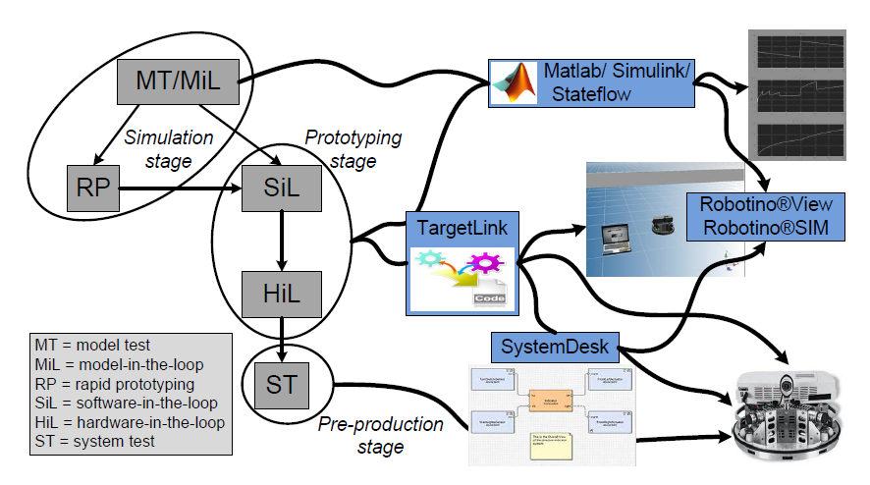
3. HPI CPSLab & Integration:
Big Picture
Methodology
Tool landscape
NEW
Hardware

Slide 3
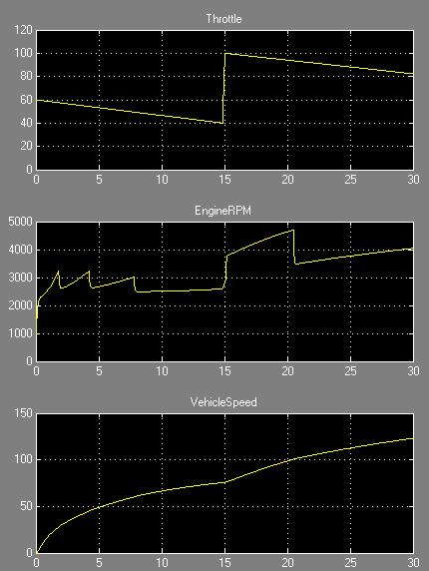
Model Test (MT)
plant
input
Output
Legend:
model
operation
input
model(s)
RoboSim
Output
control
Layer: Abstract Control Algorithm
Domains: Control/Software (+ Physics)
Multi-Paradigm: Yes, if control is discrete and input continuous
Cyber-Physical system: Yes, as control is cyber and input is (conceptually) from the physical world
Integration: Decomposition and composition-based

Slide 4
Model in the Loop (MiL)
plant
input
Output
Legend:
model
operation
model(s)
RoboSim
control
Output
plant
Layer: Abstract Control Algorithm + Idealized Plant
Domain: Control/Software + Physics
Multi-Paradigm: Yes, if control is discrete
Cyber-Physical system: Yes, as control is cyber world and plant is from the physical world
Integration: Decomposition & Composition compostion-based

Slide 5
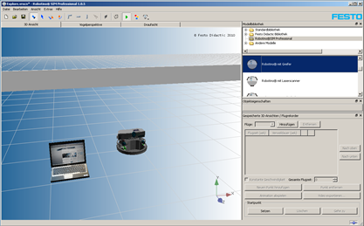
Rapid Prototyping (RP) vs. Robot Simulator
plant
plant
input
Output
Legend:
model
operation
control
Output
model(s)
RoboSim
plant
RoboSim
Layer: Abstract Control Algorithm + Realistic Plant
Domain: Control/Software + Physics
Multi-Paradigm: Yes, if control is discrete
Cyber-Physical system: Yes, as control is cyber world and plant is from the physical world
Integration: Consistency via co-simulation (tool-based)

Slide 6
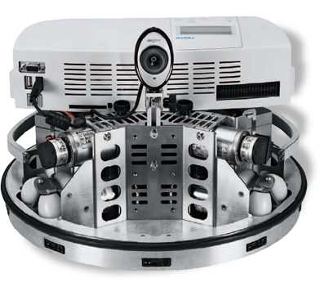
Rapid Prototyping (RP) vs. Robot
plant
input
Output
Legend:
model
operation
model(s)
control
Output
RoboSim
Layer: Abstract Control Algorithm + Real Plant
Domain: Control/Software + Real Physics
Multi-Paradigm: Yes, if control is discrete
Cyber-Physical system: Yes, as control is cyber world and plant is from the physical world
Integration: Consistency via rapid protoyping (tool-based)

Slide 7
Software in the Loop (SiL) vs. Desktop + Sim
plant
input
Output
Legend:
model
operation
control
model(s)
RoboSim
architecture
plant
RoboSim
Layer: Control Software + Architecture + Realistic Plant
Domain: Control/Software + Scheduling + Realistic Physics
Multi-Paradigm: 1) Yes, if control is discrete 2) Combine architecture and control
Cyber-Physical system: Yes, as control is cyber world and plant is from the physical world (control and architecture are both cyber)
Integration for 1): Consistency via co-simulation (tool-based)
Integration for 2): Decomposition and synthesis composition-based

Slide 8
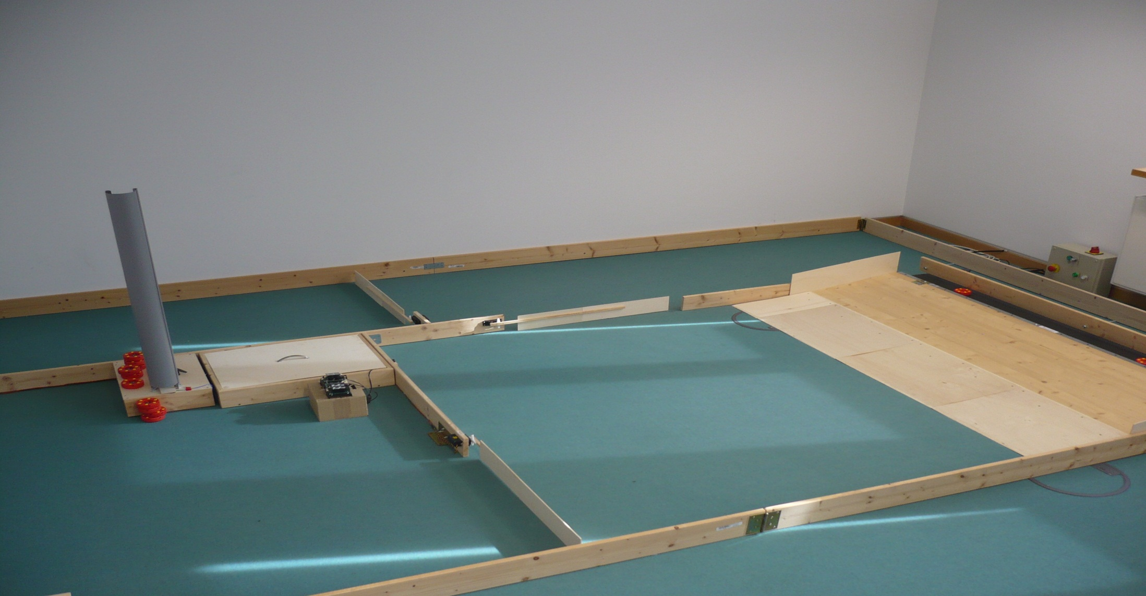
Software in the Loop (SiL) vs. Desktop + Robot
plant
input
Output
Legend:
model
operation
control
model(s)
control
control
RoboSim
architecture
Layer: Control Software + Architecture + idealized Hardware + Real Plant
Domain: Control/Software +Architecture + Scheduling + WLAN + Real Physics
Multi-Paradigm: 1) Yes, if control is discrete 2) Combine architecture and control
Cyber-Physical system: Yes, as control is cyber world and plant is from the physical world (control and architecture are both cyber)
Integration for 1): Consistency via rapid-protoyping (tool-based) via WLAN
Integration for 2): Decomposition and synthesis composition-based

Slide 9
Hardware in the Loop (HiL)
plant
input
Output
Legend:
model
operation
control
model(s)
control
control
linking
RoboSim
architecture
Layer: Control Software + Architecture + Real Hardware + Real Plant
Domain: Control/Software +Architecture + Scheduling + Real Physics
Multi-Paradigm: 1) Yes, if control is discrete 2) Combine architecture and control
Cyber-Physical system: Yes, as control is cyber world and plant is from the physical world (control and architecture are both cyber)
Integration for 1): Consistency via execution (tool-based)
Integration for 2): Decomposition and synthesis composition-based

Slide 10
MT
input
Legend:
plant
control
Output
MT/MiL
tool
MiL
model
input
control
Output
Output
plant
RP
Vertical enrichment of functional models (consistency manually)
Horizontal integration of functional and plant models
Horizontal integration of multiple functional models, an architecture model, and a plant model
Vertical enrichment of multiple functional models, an architecture model, and a plant model (to realize functions while meeting resource constraints)
control
Output
Simulation
stage
plant
RoboSim
control
Output
RP
RoboSim
SiL
SiL
control
control
control
plant
RoboSim
control
SiL
Prototyping
stage
control
control
HiL
HiL
control
control
control
limking
Pre-production
stage
ST

Slide 11
MT
input
Legend:
plant
control
Output
MT/MiL
tool
MiL
model
input
control
Output
Output
plant
RP
Vertical refinement of functional models (consistency manually)
Horizontal integration of functional and plant models
Horizontal integration of multiple functional models, an architecture model, and a plant model
Vertical refinement of functional models (to realize functions while meeting resource constraints)
control
Output
Simulation
stage
plant
RoboSim
control
Output
RP
RoboSim
SiL
SiL
control
control
control
plant
RoboSim
control
SiL
Prototyping
stage
control
control
HiL
HiL
control
control
control
limking
Pre-production
stage
ST

Slide 12
Vertical Enrichment & Transformation
plant
input
Output
MT
input
Output
Vertical enrichment of functional models and architecture
Floating-Point 2 Fix-Point to reduce resource demands models (consistency manually)
Fix-Point data-flow model 2 C-code models (consistency automatically)
Autosar 2 C-code models (consistency automatically)
control
MiL
RoboSim
control
Output
plant
RP
control
Output
plant
RoboSim
control
Output
SiL
control
control
control
plant
RoboSim
Legend:
tool
Different paradigms
model

Slide 14
Model in the Loop (MiL)
plant
input
Output
Legend:
model
operation
model(s)
RoboSim
control
Output
plant
Layer: Abstract Control Algorithm + Idealized Plant
Domain: Control/Software + Physics
Multi-Paradigm: Yes, if control is discrete
Cyber-Physical system: Yes, as control is cyber world and plant is from the physical world
Integration: Decomposition & Composition + parallel development; semantics-level

Slide 15
Scenario: Complex Horizontal Integration
“virtual integration”
control
architecture
plant
RoboSim
Horizontal combination of multiple functional models by the architecture via the generated software (integration by composition for functions, integration by abstraction for OS)
Downwards propagation can be expected, but must be managed
Upwards propagation is usually forbidden (suppressed)
Horizontal propagation is therefore also forbidden (suppressed)

Slide 16
Scenario: More Complex Horizontal Integration
“virtual integration”
control
architecture
system
VHDL
VHDLSim
hardware
plant
plant
Simulator
Horizontal combination of multiple specific structures (Autosar: software; VHDL: hardware, Matlab/Modelica: plant) via a generic structure (SysML)
Downwards propagation can be expected, but must be managed
Upwards propagation is usually forbidden (suppressed)
Horizontal propagation is therefore also forbidden (suppressed)

Slide 17
Scenario: More Complex Horizontal Integration
“virtual integration”
control
architecture
system
VHDL
VHDLSim
hardware
plant
plant
Simulator
Vertical decomposition via a generic system structure (SysML) containing multiple specific structures (Matlab: control; Autosar: software; VHDL: hardware, Matlab/Modelica: plant; ...)
Consistency between models and in the models interact, which may lead to transitive propagation/conflicts

Slide 19
Example for Approximation: Control
Control:
Design an idealized control algorithm that assumes a continuous behavior in form of a differential equation (infinite fast; no discretization errors; …)
Analyze that the idealized control algorithm provides the required guarantees (stability)
The later implemented control software and its timing is then tuned until it behaves as required (which is usually possible!)
correct
point
correct
not empty
Approximation:
Ignore later details via idealization
Do not preserve relevant properties, but assumes that later considered details can be somehow handled
Optimistic approach: a solution for the problems raised by the later considered details will likely be found

Slide 20
Example for Refinement: Protocols
set
correct
Protocol:
Design an abstract model of a protocol that captures all possible message delays
Verify that the abstract model guarantees the properties required for the protocol
The concrete protocol with specific time delays for messages will then be a refinement and thus also guarantees the required properties.
correct
Refinement:
Abstract from later details in a pessimistic manner
Preserve relevant properties
Pessimistic approach: exclude errors in later stages to be on the safe side

Slide 21
Refinement vs. Approximation
correct
set
point
correct
correct
correct
not empty
Refinement:
Abstract from later details in a pessimistic manner
Preserve relevant properties
Pessimistic approach: exclude errors in later stages to be on the safe side
Approximation:
Ignore later details via idealization
Do not preserve relevant properties, but assumes that later considered details can be somehow handled
Optimistic approach: a solution for the problems raised by the later considered details will likely be found

